Slide 1
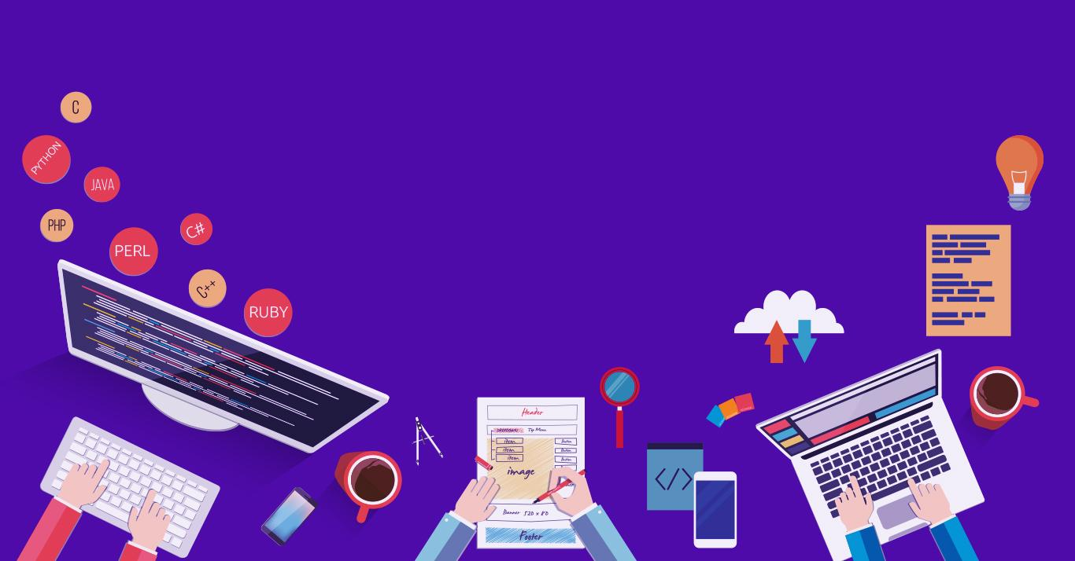

Introduction to
Robotic Process Automation
Event
Notifier
220701271
G Shreya Mridula
Guide Name
Designation and Department

Slide 2
Abstract
The goal of this project is to develop a UiPath automation workflow that enhances the management of event schedules and ensures timely reminders for stakeholders. The automation will start by extracting event data from college event website. It will then process this data to identify key event details, such as dates, times, and locations, ensuring the information is accurate and up-to-date.. Once the event schedule is validated, the bot will generate and send reminders to relevant participants, including organizers, attendees, and administrators. These reminders can be delivered via emails.

Slide 3
Need for the Proposed System
The need for an event notifier arises from the increasing complexity of managing schedules in both personal and professional environments. In today’s interconnected world, individuals often juggle multiple commitments, while organizations deal with overlapping meetings, deadlines, and project timelines. Without an efficient system to track and coordinate these events, the risk of missed appointments, double bookings, or forgotten tasks increases significantly, leading to wasted time, reduced productivity, and missed opportunities.
Manual management of schedules across various platforms, such as calendars, emails, and messaging apps, can be tedious and error-prone. Users must continuously check for updates, detect conflicts, and ensure timely reminders, which can quickly become overwhelming. An event notifier addresses these challenges by automating the entire process, offering a reliable and consistent solution to track events, send alerts, and prevent conflicts without the need for constant manual intervention.

Slide 4
Advantages of the Proposed System
The proposed event notifier model offers significant advantages by automating schedule management and ensuring seamless coordination. It saves time by eliminating manual tasks such as conflict detection and notification delivery, allowing users to focus on more important activities. With its ability to proactively identify scheduling conflicts, the model prevents double bookings and miscommunication, enhancing overall efficiency. Automated, timely notifications keep users informed and prepared for upcoming events, reducing the risk of missed appointments. Additionally, its multi-platform integration and scalability make it adaptable for both personal and organizational use, providing a reliable, customizable solution for managing complex schedules.

Slide 5
Main Objective
The main objective of the proposed event notifier is to streamline and automate the process of managing schedules and notifications, ensuring timely reminders, conflict-free planning, and efficient coordination across multiple platforms. By leveraging UiPath’s automation capabilities, the solution aims to reduce manual effort, enhance productivity, and provide a reliable system for tracking events and appointments, ultimately enabling individuals and organizations to stay organized and make better use of their time.

Slide 6
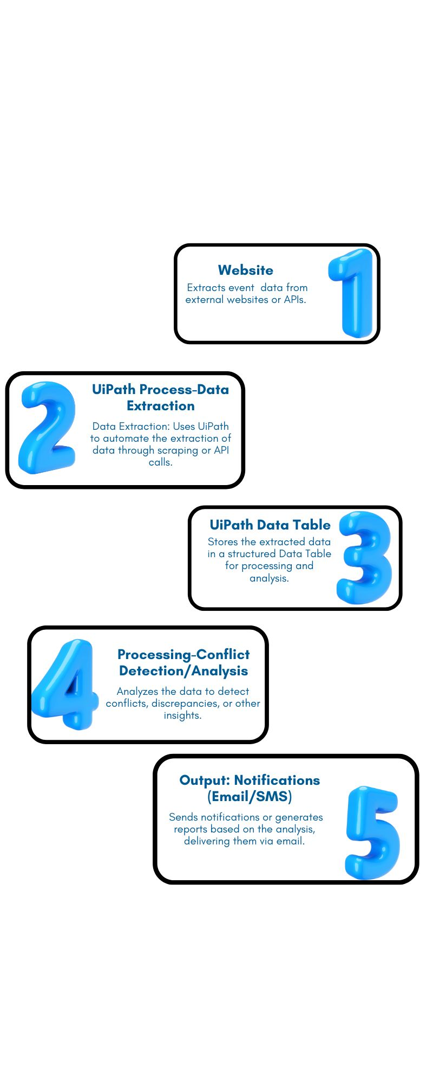
Architecture
Architecture
diagram

Slide 7
System Requirements
Hardware Requirements:
Processor:
  Minimum: Intel Core i3 or equivalent
  Recommended: Intel Core i5/i7 or equivalent (for better performance)
RAM:
  Minimum: 4 GB
  Recommended: 8 GB or higher (for handling larger datasets or more complex workflows)
Hard Disk:
  Minimum: 10 GB of free space
Software Requirements:
Operating System:
  Windows 10 or higher (64-bit recommended)
UiPath Studio:
  UiPath Studio (latest stable version) for designing and developing workflows.
Web Browser:
  Google Chrome, Firefox, or Microsoft Edge (for web scraping or data extraction)
Email/SMS Integration:
  SMTP server (for email notifications)
  Twilio or similar service (for SMS notifications)

Slide 8
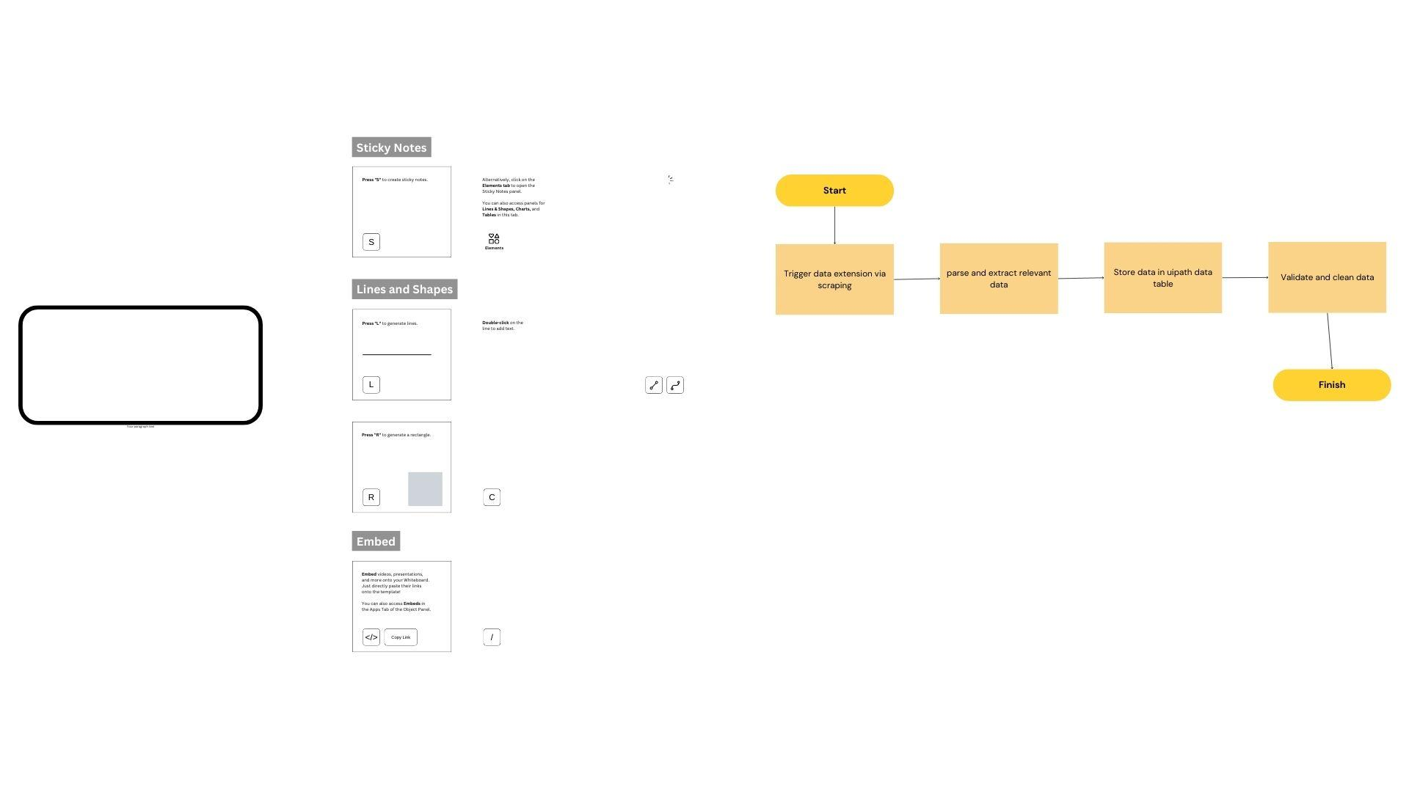
Functional Description
Module 1: Data Extraction and Storage
This module focuses on extracting data from external sources like websites and storing the extracted information into a structured format (e.g., Data Table). The module uses UiPath's data scraping and HTTP request activities to automate data collection.

Slide 9
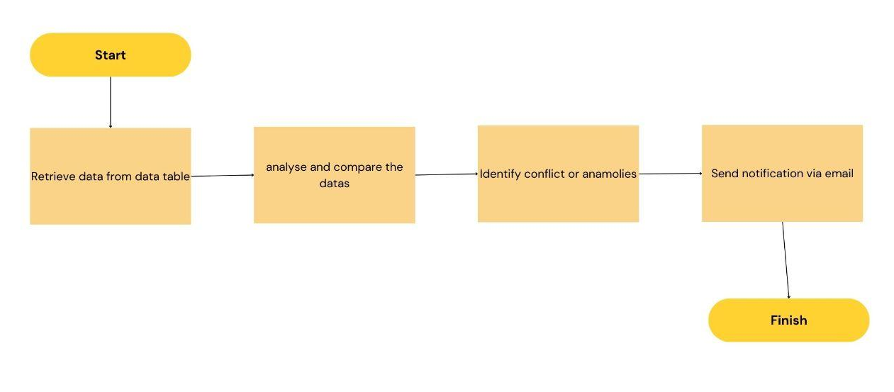
Functional description
Module 2: Conflict Detection and Notification
This module is responsible for processing the extracted data, identifying any scheduling conflicts or inconsistencies (e.g., overlapping events or data anomalies), and notifying the user via email or SMS. It uses UiPath workflows to compare data and automatically send notifications based on preset rules.

Slide 10
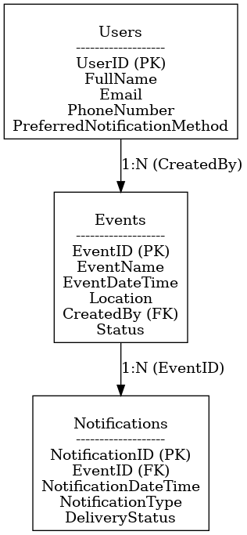
Entity Relationship Diagram

Slide 11
Process Design
Main Process: Event Notification Management
The main process ensures end-to-end automation of event management, including data extraction, conflict detection, and notifications.
Sub-Processes
1. Data Extraction and Storage
Objective: Collect data from external sources and store it in a structured format.
  Connect to data sources (websitess).
  Extract relevant data (e.g., event details).
  Validate and clean the extracted data.
  Store the data in a Data Table or database for further processing.
2. Data Processing and Analysis
Objective: Process the extracted data to detect conflicts or anomalies.
..

Slide 12
Process Design
Steps:
  Retrieve data from the Data Table
  Compare events for overlapping times or resource conflicts.
  Identify anomalies, such as missing or duplicate entries.
  Update event statuses (e.g., “Conflict,” “Scheduled”) in the database.
3. Notification Generation and Delivery
Objective: Notify users about upcoming events or detected conflicts.
Steps:
  Generate notifications based on the processed data.
  Format messages (email or SMS) with event details.
  Use email (SMTP) or SMS (e.g., Twilio) integration to send notifications.
  Log the notification status (Sent, Pending, Failed).

Slide 13
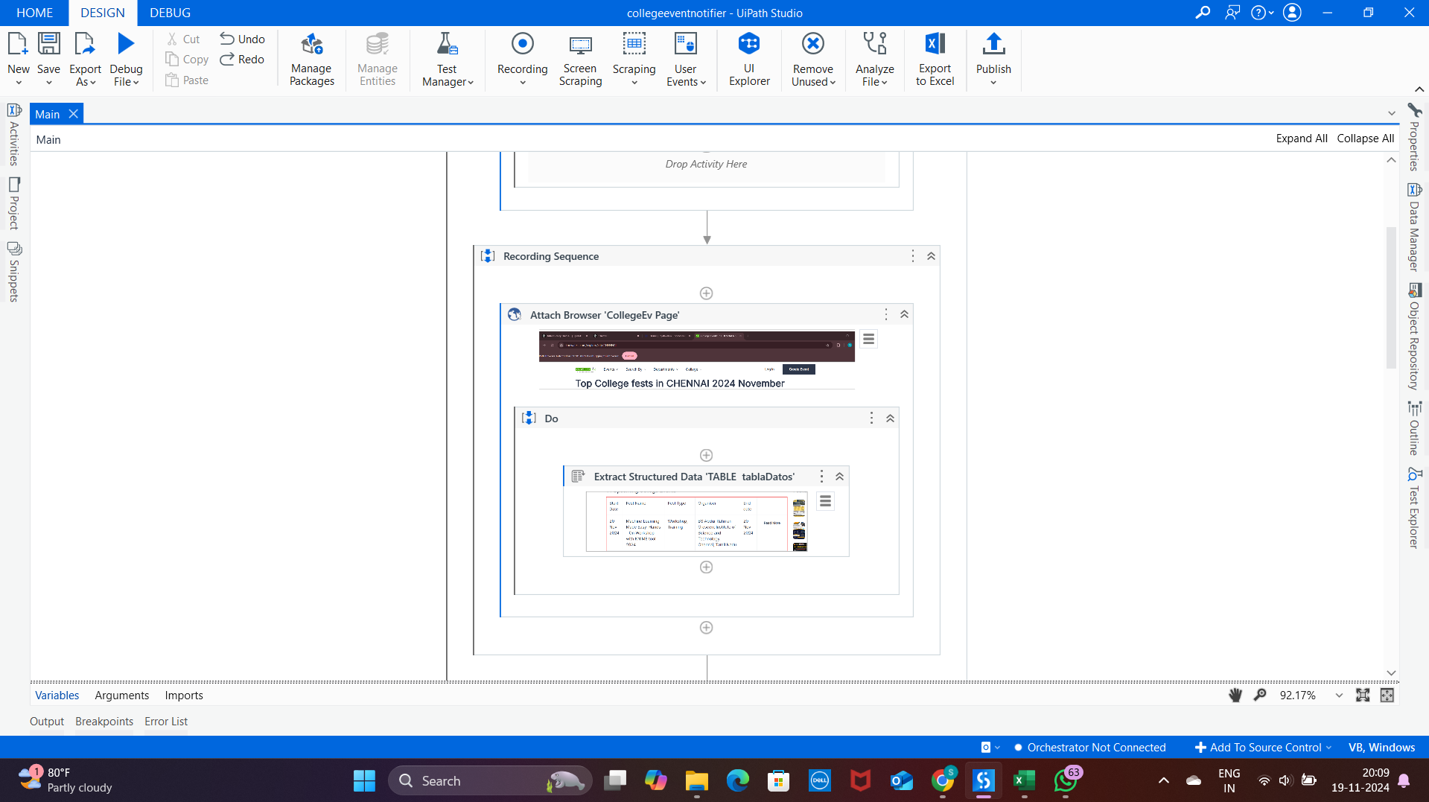
Implementation
Implementation of Module 1: Data Extraction and Storage
This module begins by automating the process of extracting data from external sources such as websites or APIs. UiPath’s Data Scraping Wizard is used for extracting tabular data from websites, while the HTTP Request activity handles API integrations to fetch data like JSON responses. Once extracted, the data is validated for missing or inconsistent values to ensure accuracy. Finally, the cleaned data is stored in a structured format, such as a UiPath Data Table, which acts as a temporary repository for further processing.

Slide 14
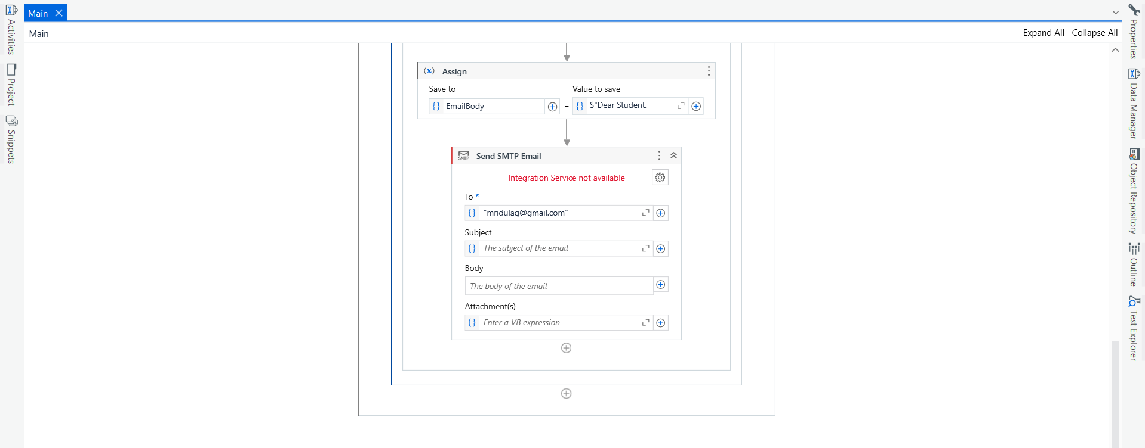
Implementation
Implementation of Module 2: Conflict Detection and Notification
The second module processes the data stored in the Data Table to identify scheduling conflicts or anomalies. UiPath compares event attributes (e.g., time overlaps) using custom workflows and updates event statuses accordingly. For notifications, the module generates customized messages based on the processed data and sends them via integrated email (SMTP) or SMS (e.g., Twilio) services. The status of each notification (Sent, Pending, Failed) is logged for tracking, ensuring timely delivery and user awareness.

Slide 15
Conclusions
The event notifier project leverages UiPath's powerful automation capabilities to simplify and enhance event management processes. By automating data extraction, conflict detection, and notifications, the system reduces manual effort, minimizes errors, and ensures timely updates for users. The modular design allows for flexibility, scalability, and adaptability to various use cases, whether managing personal schedules or organizational workflows. This solution not only saves time but also improves productivity, providing a reliable tool for effective decision-making in today’s fast-paced world.

Slide 16
Future Enhancement
The event notifier can be enhanced by incorporating advanced machine learning algorithms to predict potential scheduling conflicts based on user patterns and historical data. For instance, predictive analytics can identify high-priority tasks or suggest optimal scheduling times based on workload and user preferences. Additionally, integrating voice assistants like Amazon Alexa or Google Assistant would allow users to manage their schedules and receive notifications via voice commands, making the system more accessible and user-friendly.
Another area of enhancement is multi-platform support and integration with popular calendar applications such as Google Calendar, Microsoft Outlook, or Apple Calendar. This would enable real-time synchronization of events across different platforms. Furthermore, adding multilingual support for notifications and a mobile app interface would expand the usability of the system, catering to a broader audience and ensuring notifications are accessible anytime, anywhere. These enhancements would make the notifier more intelligent, versatile, and globally applicable.

Slide 17
IEEE Paper
IEEE Papers Related to Event Notifiers
Title: A Web-based College Event Management System and Notification Sender
  Authors: Not specified in the preview.
  Summary: This research presents a web-based application to facilitate college event management, focusing on notifications for improved accessibility and management.
  Link to Paper​
Title: Android Application on e-notifier for College Events Management using Firebase
  Authors: Not specified in the preview.
  Summary: The paper discusses the development of an Android-based event notification system utilizing Firebase for real-time updates and centralized management of college events.
  Link to Paper​

Slide 18
References
Title: Design and Development of an Automated Notification System for Event Management
  Authors: Nitin R. Suryawanshi, Priyanka D. More
  Journal: International Journal of Engineering Research and Technology (IJERT)
Title: Event Management System with Integrated Email Notification
  Authors: Sara Ahmed, Mohd. Tariq
  Journal: International Journal of Computer Science and Information Technologies (IJCSIT)

Slide 19
Queries

Slide 20
Demonstration

Slide 21
Thank You

